Slide 1
Packaging computational biology tools for broad distribution and ease-of-reuse
Matthew Vaughn @mattdotvaughn
Director, Life Sciences Computing
Texas Advanced Computing Center
http://www.slideshare.net/mattdotvaughn

Slide 2
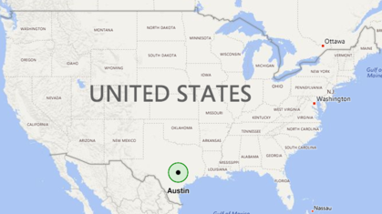
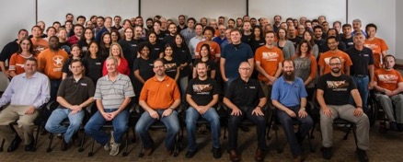
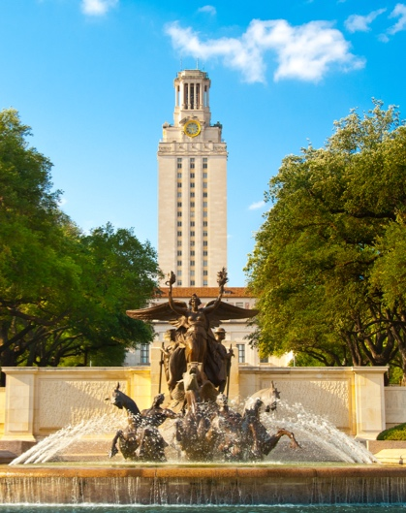
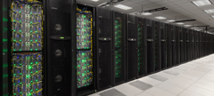
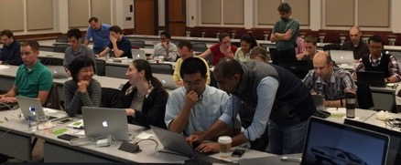
TACC AT A GLANCE
Personnel
160 Full time staff (~70 PhD)
Facilities
10 MW Data center capacity
Redundant facilities for storage & hosting
Systems and Services
A Billion compute hours per year
5 Billion files, 50 Petabytes of Data, Hundreds of Public Datasets
Capacity & Services
HPC, HTC, Visualization, Large scale data storage, Cloud computing
Consulting, Curation and analysis, Code optimization, Portals and Gateways, Web service APIs, Training and Outreach

Slide 3
SCIENTIFIC COMPUTING: EARLY DAYS
C/C++/FORTRAN/PERL/SHELL
MPI
LAPACK/BLAS/PETSC
SGE
UNIX
X86/PPC/SPARC

Slide 4
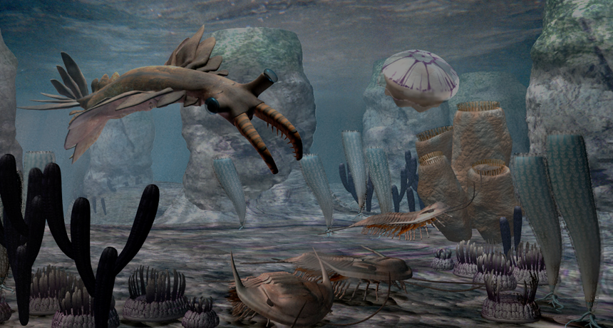
SCIENTIFIC COMPUTING: NOW
LANGUAGES
Python 2 & 3
R
Julia
Perl
Matlab
Java
Scala, Clojure, etc
.NET
C/C++
Swift
Haskell
Go
Javascript
FRAMEWORKS
MapReduce Hadoop, Storm, Pachyderm, Cloudera
Event & Streaming: Kinesis, Azure Stream Analytics, Camel, Streambase
Deep/Machine Learning: Watson, Azure BI, Tensorflow, Caffe
In-memory parsing: Kognito, Apache Spark
Containers: Docker, Rocket, MESOS, Kubernetes
Cloud: AWS, GCE, OpenStack, vCloud, Azure
HARDWARE
Many-core computing - 50-100 threads/node*
Xeon / Xeon Phi
GPU
OpenPower
ARM
ShenWei
Multi-level memory architecture
Hierarchical storage
FPGAs
Quantum-like systems
Notes:
Driven by BIG DATA and its relentless adoption by non-traditional users of Scientific Computing

Slide 5
NOT JUST ONE DATA TSUNAMI BUT THOUSANDS OF THEM
Notes:
Everyone’s generating TERASCALE DATA
Data spread is real

Slide 6
EMERGENCE OF CLOUD TECHNOLOGY AND BUSINESS MODELS
Notes:
NOBODY WANTS TO DO CAPEX

Slide 7
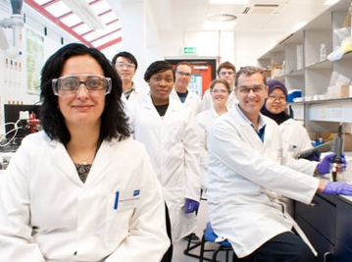
DEMOCRATIZED COMPUTING
Mike
Computing novice
Works remotely at partner site
Eliza
Masters specific computing analysis skills
Readily adopts new technology
Paulo
Staff computational expert
Supports multiple projects
Nikolaidas Group
Mostly experimentalists
Strict data sharing & access rules
Roshan
Computationally experienced
Focused on interpretation
Notes:
EVERYBODY IS COMPUTING

Slide 8
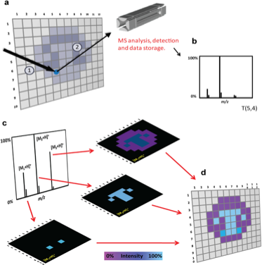
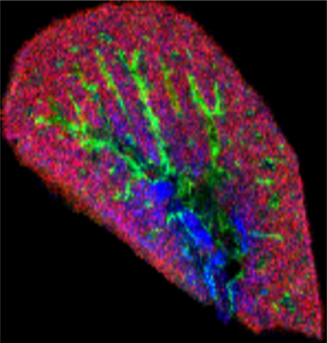
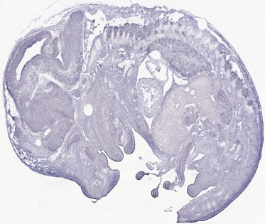
Their needs (30,000 ft view)
Store, organize, share measured data
Do (and re-do) perform 1’ analyses
Store, organize, share derived data results
Invent and explore hypotheses
Share analysis code with the scientific public
Integrate results from new experiments
Publish data and plots, visualizations and analysis tools

Slide 9
Their needs (500 ft view)
Data lifecycle management
Fine-grained permissions and roles
Discoverability
Version control
Domesticating promising new analysis codes
Wrestling with immature technology
Making their science internally reproducible
Adopting efficient analytical methods

Slide 10
HOW DO WE HELP RESEARCHERS WITH DIVERSE NEEDS AND BACKGROUNDS KEEP UP WITH ADVANCES IN COMPUTATIONAL BIOLOGY?
Notes:
Make technologies available to them. Train folks how to use.

Slide 11
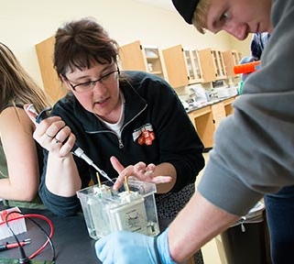
ESSENTIAL DRIVERS
I need to customize my research environment
I need to share my research environment with others
I need to teach others how to use my research environment
Notes:
The drivers for computational biology are the same as for laboratory science

Slide 12
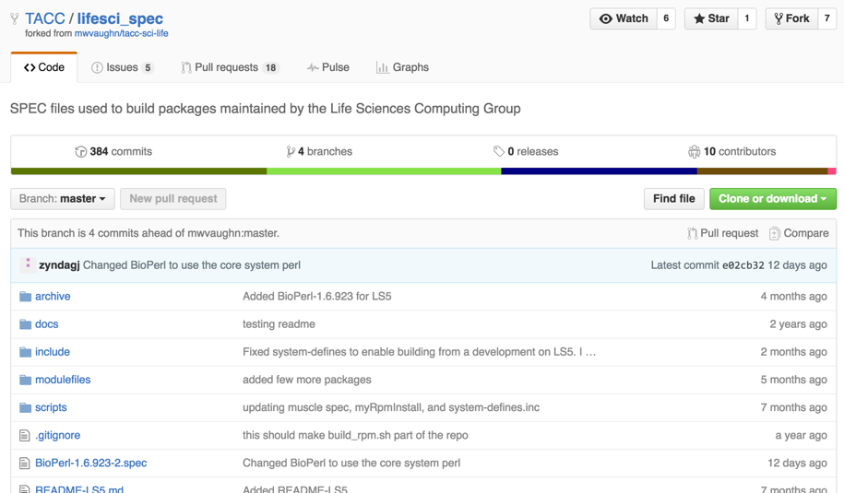
Customizing THE HPC environment
INSTALL PACKAGE X, VERSION 1.0.1 ON RESOURCE Y?
TACC Life Sciences Strategy
Maintain public Github repo of build instructions for RPMs
Contributions accepted via pull request or direct from trusted partner
TACC staff build, test, install RPMs
RPMs are relocatable, stored for re-use in future
Software is discoverable via modules
Similar concept to Rocks Rolls. See also… BioLinux.
TACC LSC spec repository

Slide 13
PROS AND CONS
PROS
Direct path for community contribution
Digital footprint is small: Spec files + RPM artifacts
Build instructions are discoverable, version controlled, attributable
Resulting digital artifacts are reusable on the host system
CONS
Learning curve is steep. Need to master RPM build system plus host-specific build systems
TACC staff still have to build/test/deploy
SPEC files have dialects. Impedes portability between systems.
RPMs only work on target system.
VERDICT: NOT HELPFUL AT ALL FOR TRAINING. DOES IMPROVE THE WORK ENVIRONMENT.

Slide 14
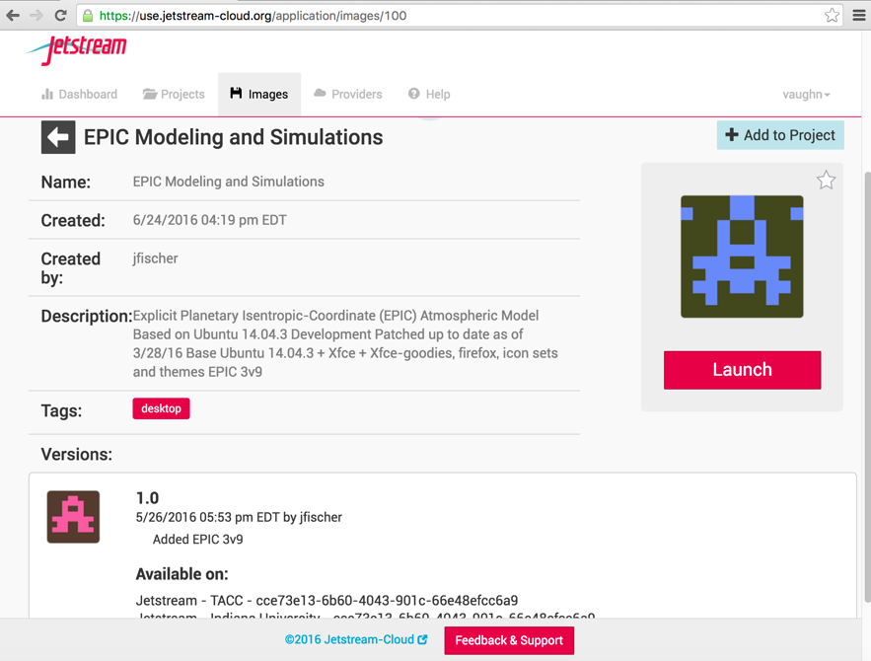
SHAREABLE VM IMAGES AND DATA
PROVIDE A COMPLETE COMPUTER THAT CAN RUN PACKAGE X, VERSION 1.0.1
OpenStack + Science-oriented GUI
Cyverse Atmosphere (UA/TACC)
XSEDE Jetstream (IU/TACC)
NSF Chameleon (UC/TACC)
Users extend and share VM images configured with specific software
Users can share data volumes
VMs can be set up multi-user
VMs can be exported and published
95% self-service!
Screenshot from Jetstream, early user period

Slide 15
PROS AND CONS
PROS
Entirely self-service VM image publishing
Versioned VM images plus extra metadata is good for reproducible analysis
Learning curve for USING the cloud system is shallow
Learning curve for building and sharing VMs is modest
Multiple operating systems are supported
CONS
Portability between cloud providers is limited
Orchestrating 2+ VMs is very difficult
Digital footprint is the application plus OS, per version
Requires either purchase of commercial cloud capacity or sustained investment in private cloud (OS/Euc/Nebula)
VERDICT: QUITE HELPFUL FOR TRAINING OR SOFTWARE SHARING, BUT…

Slide 16
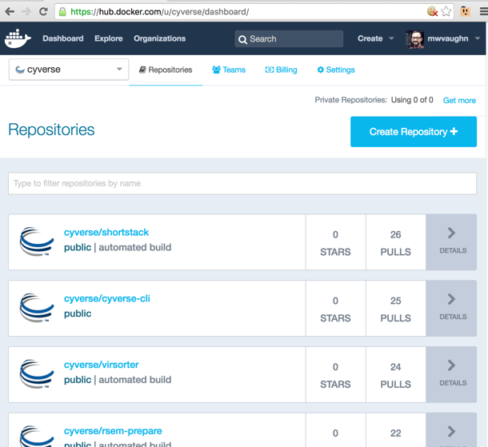
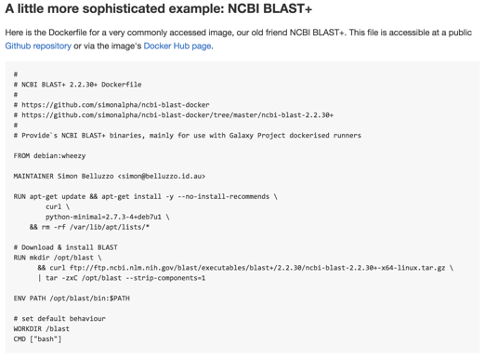
Container TECHNOLOGIES
PROVIDE ONLY THE FILES & DEPENDENCIES FOR PACKAGE X, VERSION 1.0.1
Cyverse and other TACC projects use Docker
Package software + dependencies + essential configuration
Based on a file (Dockerfile, for instance) that can be shared and maintained under version control
Synergistic with VM and web service approaches
Unites deployment strategy for a platform and its hosted software
Exemplar Dockerfile for teaching the basics of containerization
DockerHub is one public repository for images

Slide 17
PROS AND CONS
PROS
Minimal storage footprint – just the deltas beyond base operating system footprint
Instructions for building images are plaintext files in a DSL
Images can be made FAIR via standards and public repositories
Students eagerly adopt docker run x:1.0.1 command
CONS
Usage requires reasonable understanding of key Linux technologies
Images themselves lack documentation and validation
Software must be based on Linux kernel 3.10+
Not optimized for large or persistent data
Most public-funded infrastructure does not support containers
VERDICT: HELPFUL FOR SHARING AND TEACHING, IF USED & RESOURCED PROPERLY

Slide 18
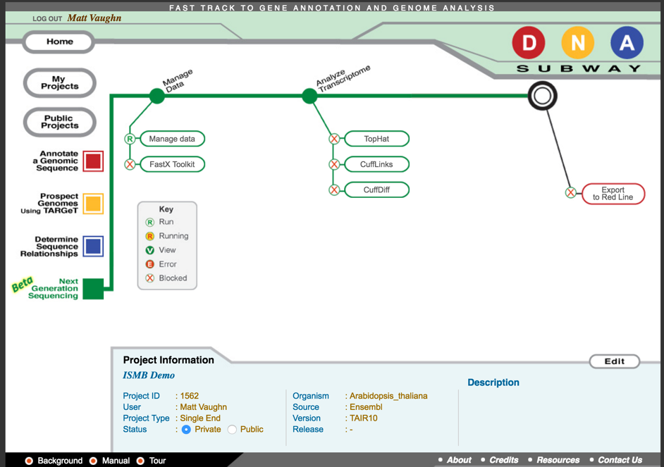
WEB SERVICE APIS
PROVIDE ABSTRACT ABILITY TO RUN PACKAGE X, VERSION 1.0.1 ON RESOURCE Y
TACC/Cyverse Agave API
Package scientific applications as nodes in a workflow
Model 1' and 2' data + host resources as dependencies
Handle validation+invocation, data marshaling+management, resource brokering+coordination, identity+access for the user
Use either GUIs, language libraries, or direct service calls for access
DNA Subway runs real-scale NGS tools on TACC & AWS

Slide 19
PROS AND CONS
PROS
Digital footprint is small: Application + dependencies only
Compute and storage protocols are abstracted from end users
Provenance is captured and maintained
CONS
Requires non-trivial investment by tool developers
Direct usage (not via portal) is challenging for end users
Expectation management and user support for end users is challenging
Requires sustained investment in maintaining the services platform in addition to its resources
VERDICT: HELPFUL TO ENABLE USE OF REAL-SCALE TOOLS & DATA
Notes:
Less than half of Cyverse web service tools contributed by 1’ author. I’ll wager similar number at Galaxy toolshed, various Docker repos for science.

Slide 20
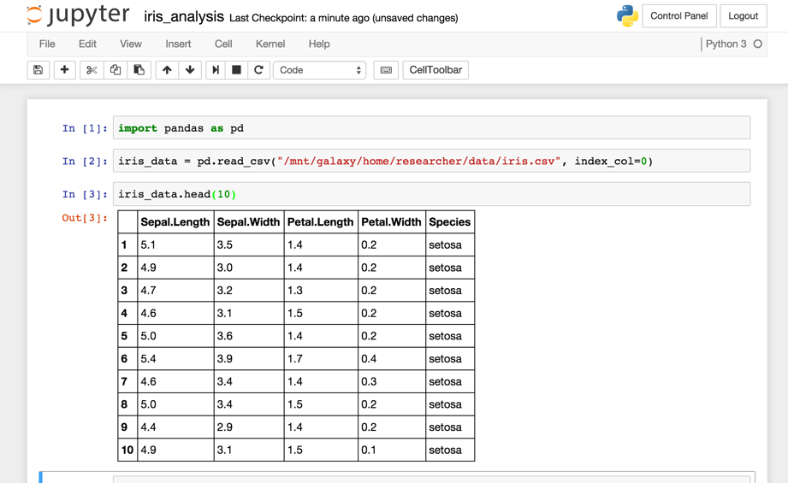
JUPYTER NOTEBOOKS
DOCUMENT ALL THE STEPS AROUND RUNNING PACKAGE X, VERSION 1.0.1
TACC provides Jupyter Notebook support on its HPC systems and hosted JupyterHub in its API platform
Narrative, rich-text interface with embedded media
In-line code execution for key languages such as Python, Julia, Go, Haskell, R, Torch
Interactive, exploratory computing
Notebooks themselves are self-contained sharable documents
Part of a larger strategy to support interactive mode computing: Rstudio, Mathematica, SAGE, and Matlab
Loading the Iris Data Set, used for teaching statistical classification techniques, into a Jupyter notebook

Slide 21
PROS AND CONS
PROS
Digital footprint is small: Notebooks are text docs
Narrative support plus interactive widgets are first-class aspects
Closest analog yet to team programming (but async!)
CONS
Notebook infrastructure itself needs resourcing
Notebooks don’t natively provide the software or data dependencies for a given workflow
They also don’t scale (natively)
Need to train end users in how to use Notebooks + the specific bioinformatics skills
VERDICT: FANTASTIC PLATFORM TO AUTHOR INTERACTIVE TUTORIALS & GUIDES, BUT…
Notes:
Less than half of Cyverse web service tools contributed by 1’ author. I’ll wager similar number at Galaxy toolshed, various Docker repos for science.

Slide 22
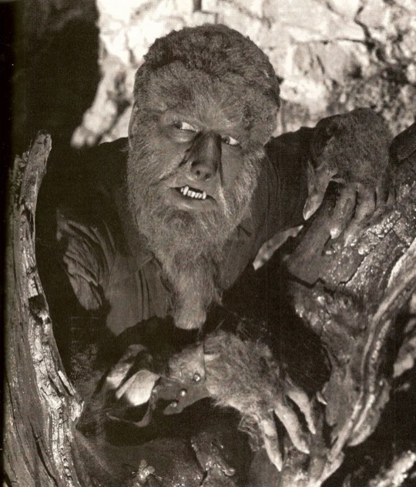
NO SILVER BULLETS
Installable RPMs aren’t that easy to build
VM s aren’t always portable or scalable
Jupyter Notebooks need pre-configured hosts
Containers need support for persistent data
The cloud is an abstraction for “someone else’s problem”
THESE TOOLS COMPLEMENT ONE ANOTHER
Bioinformatics training

Slide 23
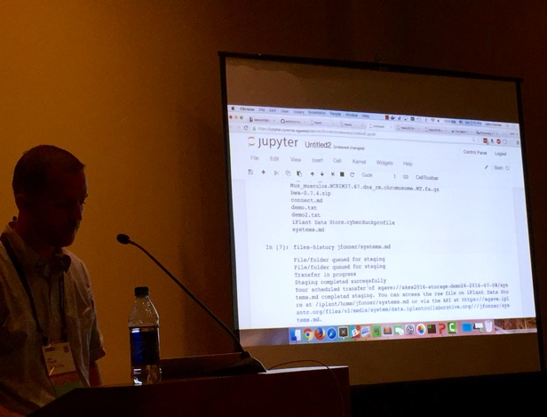
ENSEMBLES VS ONE-MAN BANDS
AKES01: Clouds, Clusters, and Containers: Tools for responsible, collaborative computing
JupyterHub hosted on XSEDE Jetstream
Multiuser Docker host hosted on XSEDE Jetstream
Web shell for access even from tablets
Jupyter notebooks pre-configured to interact with Agave APIs
Storage on Cyverse Data Store cloud
Application registry @ Cyverse App catalog
Using DockerHub & Github commercial resources
Skills focus
Containerization 101 + Web services 101
Sharing and publishing data, code, and results
Provenance and other metadata
John Fonner from TACC demonstrating file provenance within Cyverse

Slide 24
QUESTIONS AND DISCUSSIONS

