Slide 1
Integrating Data in a Microbiome Context
Michael Shaffer
Catherine Lozupone, Ph.D
Rocky 2014

Slide 2
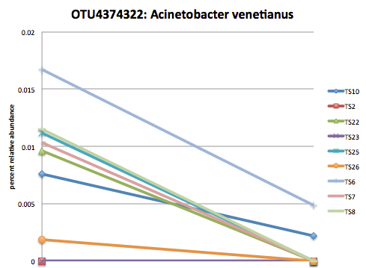
Nasal Microbiome as Air Purifier
What is a microbiome?
Acinetobacter venetianus abundance decreases in asthmatic co-twins
Does A. venetianus protect against asthma?
Does the nasal microbiome contribute to the biotransformations of foreign materials in the nose?
Can we identify biotransformers of polyaromatic hydrocarbons in the human nose?
Non-Asthmatic
Co-twin
Asthmatic
Co-twin
Notes:
Microbiome is the collection of bacteria in a community such as an area of the human body like the gut or lung. We are interested in the nose.
We looked at the nasal microbiome of identical twins disconcordant for asthma and found a near universal decrease in abundance of the bacteria Acinetobacter venetianus across twin pairs. Acinetobacter venetianus experiements have shown that it has a role of degrading large carbon compounds such as known asthma exacerbators. We already know that the nose is able to clean the air we breathe via human genes so we questioned if it could be involved in the degradation of similar compounds in the nose and therefore have a protective effect against asthma.
And from that we extended our question to ask whether the nasal microbiome contribues to the biotransformations of foreign materials in the nose and if we can identify microbes that contribute to this metabolism?

Slide 3
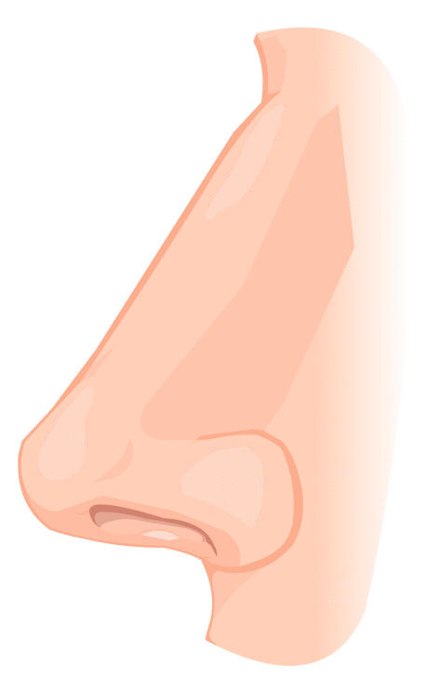
Integrating Various Data Types
Data sources:
16S sequencing
Metabolomics
RNA-Seq
Human/Environmental Factors
What are the contributions of the nasal microbiota to biotransformations of PAH in the nose?
metagenome
16S
metabolome
?
Notes:
To study this we are using many different data types in order to attack this metabolic question from a variety of angles
16S sequencing identifies microbes present and can be used to impute a metagenome (set of genes present) using software (PICRUSt), metabolomics tells us the small molecules present in a sample, RNASeq (piloting in two people for cost reasons)
We also have information on the human cells in this environment such as the epigenome and transcriptome
So how can we bring these data types together to explore the role of microbes in PAH degradation in the nose

Slide 4
Visualizing Metabolic Activity of a Microbiome
TAXA1
TAXA2
TAXA3
GENE1
GENE2
GENE3
GENE4
CO2
CO4
CO6
CO1
RXN1
RXN2
RXN3
CO3
CO5
CO7
TAXA
From 16S or metagenomics
GENE
From PICRUSt or
metagenomics or transcriptomics
RXN
From KEGG
CO3
From KEGG or metabolomics
Notes:
This is a cartoon showing a network with the types of data that we are using to explore this data.
So 16S is the base that we start our exploration of these communities with and we want to find which of these are capable of metabolizing PAHs
(Click)
And this is our metabolic network of our degradation which we retrieve from a database. A PAH of interest would be a compound in this network so we want to know which microbes will be able to do this metabolism. So how do we figure out the bacteria which are capable of this reactions?
(Click)
This information comes from the genes.
(Click)
The genes are encoded by the genome of a taxa or set of taxa. This information comes from the PICRUSt program earlier which contains imputed genomes for 16S sequences.
(Click)
And the products of these genes are capable of catalyzing reactions which would lead to the degradation of these compounds. This information comes from the same database as our reactions and tells us what reactions genes are capable of. So with this complete network we can attempt to identify taxa which are putative PAH degraders. For this preliminary study we are able to do all this with only 16S data but other data sources can be integrated into various stages of the study design.

Slide 5
Predicting PAH Biotransformers
Given a list of compounds can we predict what bacteria will be able to degrade them?
Does the species encode a gene which directly reacts with the compound of interest?
Is the species present across samples and abundant within those samples?
Test these predictions on the bench
Bacteria with genes to process various compounds
Bacteria | Naphthalene | Chrysene | Benzo [a] pyrene | Anthracene | Phenanthrene | Samples Present | Average count
Pseudomonas | 0 | 0 | 1 | 0 | 1 | 55 | 295
Micrococcus | 0 | 1 | 1 | 1 | 1 | 37 | 47
Alicycliphilus | 4 | 1 | 4 | 5 | 1 | 23 | 27
Pseudomonas | 0 | 0 | 1 | 0 | 1 | 53 | 12
Notes:
We used this data to ask if a list of specific compounds could be degraded by any microbes in our sample. To do this we asked two questions: does this species encode a gene which can react directly with the compound of interest and does this species seem to be abundant across and within samples.
We identified four species of interest predicted to be able to process one or more of these compounds as shown in the table here. All of these species are known degraders of large aromatic compounds. Now that we have made these predictions we will test them by both trying to sequence out the genes identified as present and PAH degraders as well as culture experiments to see if these bacteria could live off the identified compounds as their carbon source.

Slide 6
Future Directions
Integrate metatranscriptome data with predicted and measured metagenome levels
Integrate data from bacteria with human and exposure data
Acknowledgements
Lozupone Lab:
Catherine Lozupone
Moshe Rhodes
Jody Donnelly
Reisdorph Lab:
Nichole Reisdorph
Kevin Quinn
David Schwartz
Ivana Yang
Elizabeth Davidson
Corrine Hennessy
Andy Liu
Stan Szefler
Brett Haberstick
Allison Schiltz
Lisa Cicutto
Computational Bioscience Program
Notes:
So in the future we want to use more than just the 16S data as well as information from databases to observe and predict interaction in this microbial community.

